Slide 1

TrendyPlus
Social Network Trendy Sharing

Slide 2

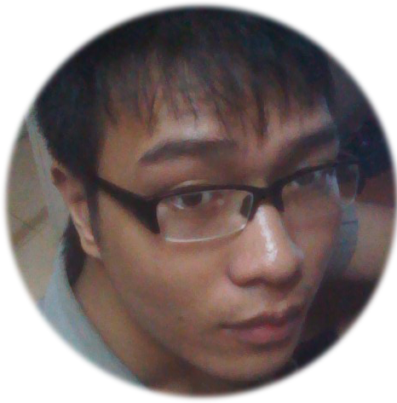


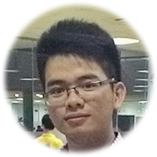

TrendyPlus Team
Đặng Mạnh Cường
Team Leader
Lê Trung Anh
Team Member
Vũ Tuấn Nghĩa
Team Member
Mr. Nguyễn Tất Trung
Supervisor
Nguyễn Đức Nam
Team Member
Đỗ Thành Luân
Team Member
Notes:
Nhóm TrendyPlus Team được hướng dẫn bởi thầy NTT Nhóm em gồm 5 thành viên bao gồm có:

Slide 3
Content
1
Project Background
2
Project Management Plan
3
Requirement Specification
4
Software Design
5
Testing
6
Lesson Learned
7
Demo – Q&A
Notes:
Trên màn hình là phần content, nội dung các phần trong buổi bảo vệ của bọn e ngày hôm nay

Slide 4
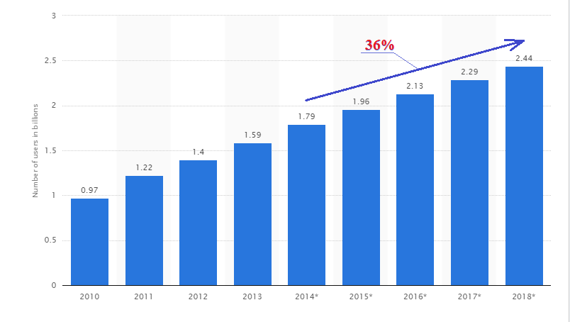
Project Background
Number of social network users worldwide from 2010 to 2018 (in billions)
http://www.statista.com/statistics/278414/number-of-worldwide-social-network-users/
Notes:
-Trên slide là biểu đồ số người sử dụng mạng xã hội từ năm 2010 đến 2018
2014: 1,8 tỉ người sử dụng -> 2018: 2,4 tỉ người
Tăng 36% : đây là thị trường màu mỡ dành cho công nghệ thông tin nói chung và các deverloper nói riêng

Slide 5


Project Background
2 Anticipated Social Media Trends in 2015
http://www.socialmediatoday.com/content/top-7-anticipated-social-media-trends-2015
Notes:
Với sự bùng nổ, phát triển mạnh mẽ của mạng xã hội trong 5 năm trở lại đây là 1 thách thức đối với những nhà phát triển để đi tìm những hướng đi mới. Trong 2015 có 2 xu hướng chính dành cho mạng xã hội đó là Using image (sử dụng hình ảnh – vì chúng ta biết là 1 hình ảnh bằng triệu lời nói) và real time (thời gian tương tác thực)

Slide 6

Project Background
Notes:
Trong tình hình cụ thể hiện nay, chúng e có tìm hiểu 2 mạng xã hội nổi tiếng với số người sử dụng đứng đầu đó là mạng xã hội facebook và instagram
Facebook giống như 1 blog cá nhân dùng để chia sẻ video, status và ảnh yêu thích mang tính cá nhân của user
Còn Insta là mạng xã hội chuyên về chia sẻ ảnh và video yêu thích nhưng cũng chỉ mang tính chất cá nhân
Bọn e nhận ra còn 1 mảng về xu hướng thời trang thì chưa có mạng xã hội hướng đến cả và bọn em nhắm đến điều đó

Slide 7
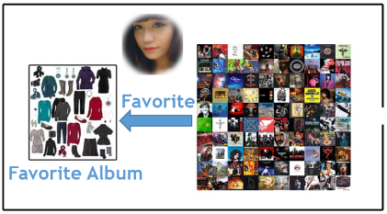
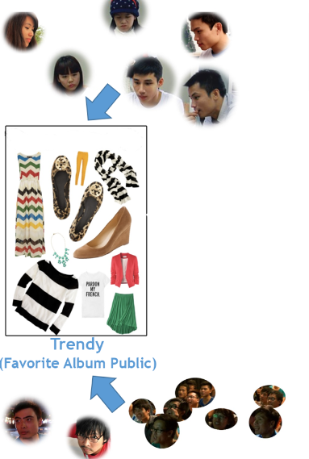

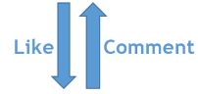
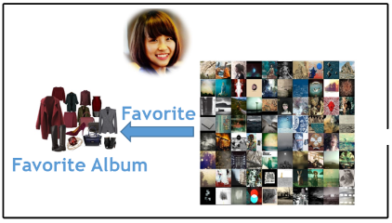
Our Idea
POST
ZScore Algorithm
POST
23H59’
TIME
Notes:
Dựa vào sự phát triển mạnh mẽ của MXH, vào xu hướng trong năm 2015 và nghiên cứu về các mạng XH phổ biến
Nhóm e đã có ý tưởng tạo nên 1 mạng xã hội về chia sẻ ảnh
Trong các MXH chia sẻ anh như FB hay Insta thì mỗi User khi đăng ảnh lên sẽ có 1 ma trận ảnh riêng..
Các user tương tác vs nhau thông qua like, comment, ngoài ra mỗi User đề có 1 Album favorite, bọn e hiểu ngầm “Tủ yêu thích”- chứa những bức ảnh riêng, những bức ảnh yêu thích, nhưng chỉ mang tính chất cá nhân.
Câu hỏi đặt ra là: nếu 2 user ko phải bạn bè thì cũng ko thể biết dc sở thích của nhau. Mà có là bạn bè thì cũng ko biết sở thích của mọi người là cái gì?
Để trả lời cho câu hỏi hóc búa đó, thì bọn em đưa ra 1 giải pháp-> Ý tưởng tạo ra 1 chiêc “Tủ” chung Trendy hay có thể hiểu nôm na là favorite album public, Nó bao gồm 1 list các ảnh đc quan tâm, tương tác nhiều nhất thông qua thuật toán Zscore (phân bố xác suất) trong 1 khoảng thời gian và đó chính là xu hướng, trái tim của đồ án chúng em

Slide 8
Main Objectives
Help users to view the Trendy Immediate
Support buying fashion items easily
Notes:
Với MXH TrendyPlus, người dung dễ dàng nhìn ra được xu hướng thời trang hiện tại
Ngoài ra MXH TrendyPlus của bọn em còn tích hợp với googlemaps từ đó người dung sẽ dễ dàng biết được cửa hang nào có những món đồ hot nhất hiện nay

Slide 9
Scope
In scope
Trendy
Around Here
Out Scope
Instant Messages
Videos Upload
User Page
Shop Page
Admin Page
Notification
Suggestion
Follow
Favorite
Mobile Support
In scope
Notes:
Tiếp theo là phần In Scope – Out Scope của bọn em

Slide 10
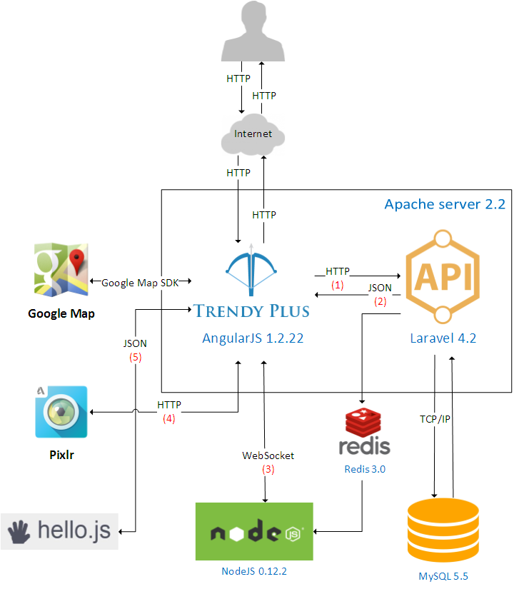
Proposal System
Editor Image
Manage Authentication
Build
Real - Time

Slide 11
Content
1
Project Background
2
Project Management Plan
3
Requirement Specification
4
Software Design
5
Testing
6
Lesson Learned
7
Demo – Q&A

Slide 12
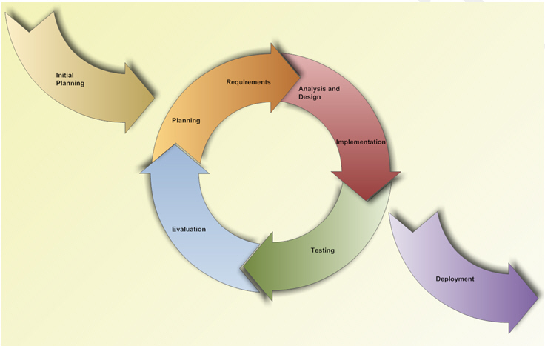
Software Process Model
In scope
Notes:
Về quy trình phần mềm thì bọn e chọn mô hình: interative and Incremental Tại sao bọn em lại chọn mô hình này? Với những sinh viên lần đầu tiên được làm dự án Từ A đến Z như bọn em: từ lên ý tưởng, viết tài liệu, phân tích thiết kế, code, test thì đây là 1 mô hình rất linh hoạt đối và phù hợp với bọn em

Slide 13





Team Work
Time: 6 hours/day, 5 days/week.
Location: FPT University, D402 – KTX FU HL.
Communication:
Meeting supervisor: Once a week.
Team building: Once a month.
In scope
Notes:
Ngoài việc học 3 môn chuyên ngành khá nặng thì chúng em vẫn cố gắng để có thể dành ra 6 tiếng mỗi ngày và 5 ngày trên tuần dành cho đồ án
Tiện cho công việc trao đổi thông tin, hỗ trợ lẫn nhau của các thành viên nhóm, chúng em đã chấp nhận dọn tới ở chung với nhau trên phòng D402 KTX

Slide 14
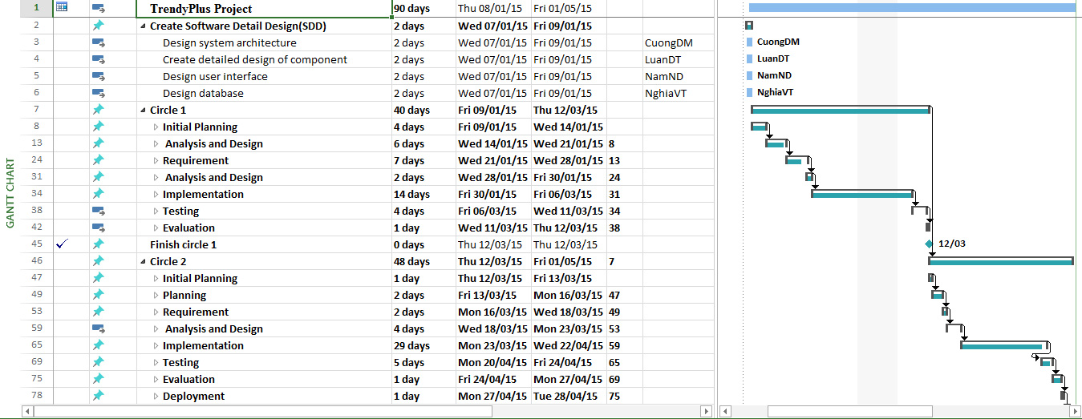
Project Planning
In scope
Notes:
Project management plan

Slide 15








Project Tools
Google Chrome
43.0
Microsoft Office 2013
Enterprise Architect 12
PHPStorm 8.0
In scope
Redmin 1.4
HTML5 & CSS3
GitHub 2.2.0
Redis 3.0
Notes:
Redis ???

Slide 16





Technologies
In scope
PHP 5.6
Laravel 4.2
NodeJS 0.12.1
MySQL 5.5
AngularJS 1.2.22
Notes:
Node JS Angular JS

Slide 17
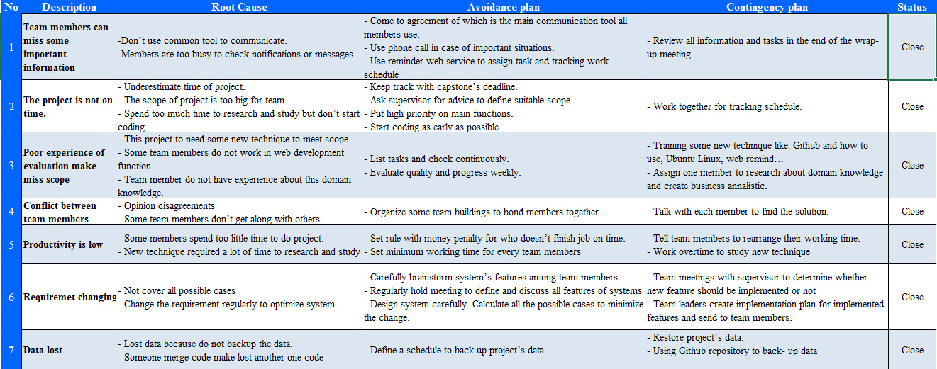
Risk Management
In scope

Slide 18
Content
1
Project Background
2
Project Management Plan
3
Requirement Specification
4
Software Design
5
Testing
6
Lesson Learned
7
Demo – Q&A

Slide 19
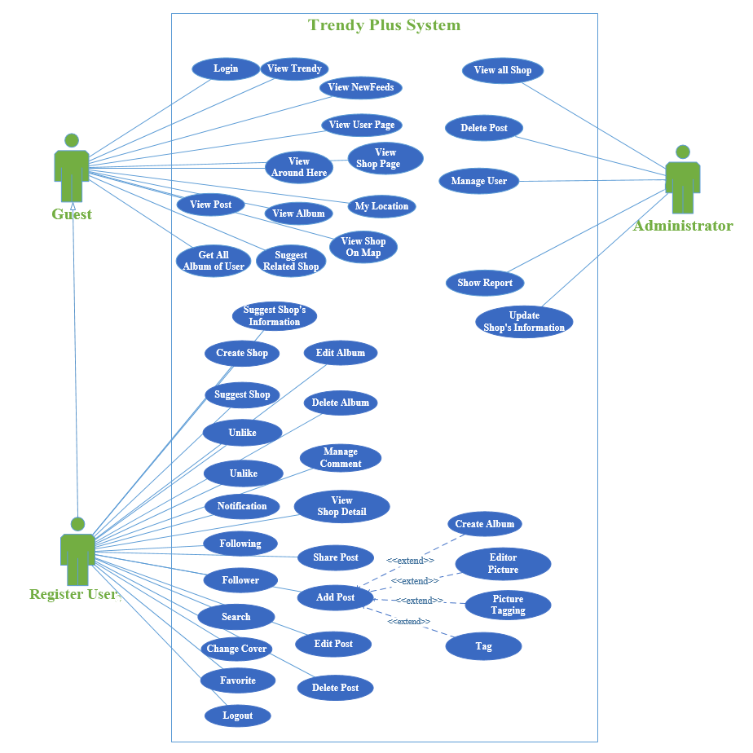
Use Case Diagram
59
Guest
Register User
Administrator
Use Case

Slide 20
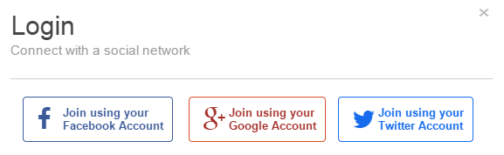
Guest
Login
View Trendy
View Newsfeed
View User page
View Around here
My Location
View Album
View Post
View Shop on Map
Suggestion

Slide 21
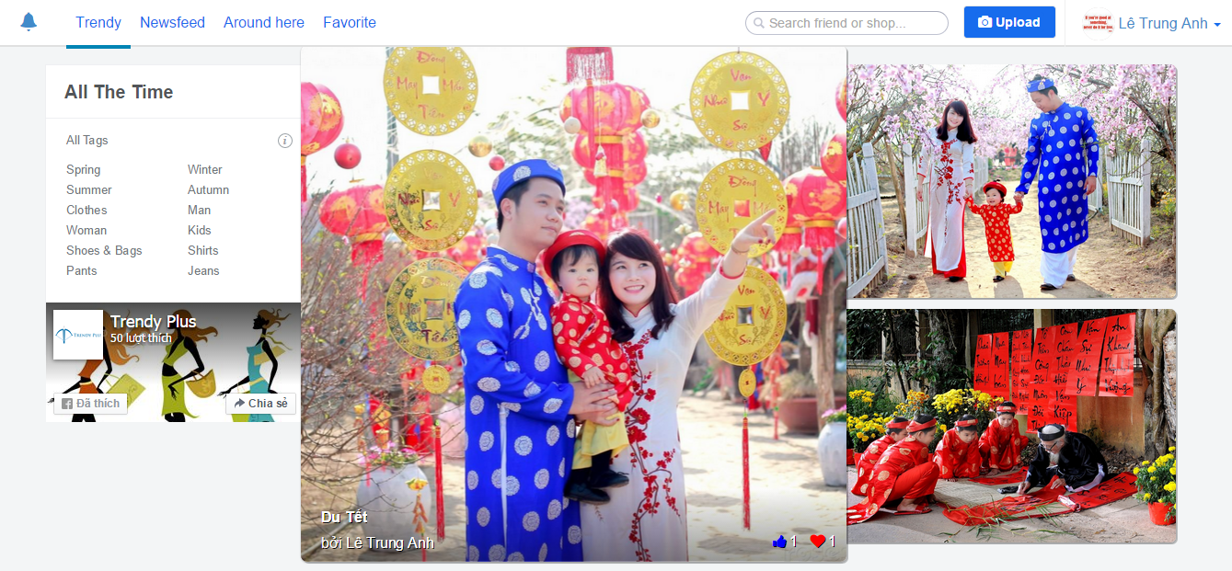
Guest
Login
View Trendy
View Newsfeed
View User page
View Around here
My Location
View Album
View Post
View Shop on Map
Suggestion

Slide 22
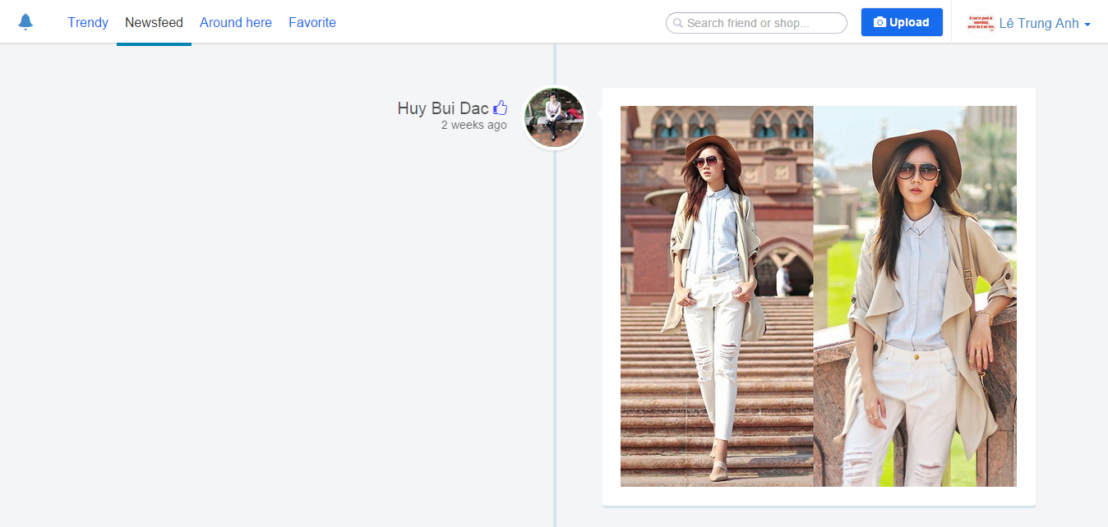
Guest
Login
View Trendy
View Newsfeed
View User page
View Around here
My Location
View Album
View Post
View Shop on Map
Suggestion

Slide 23
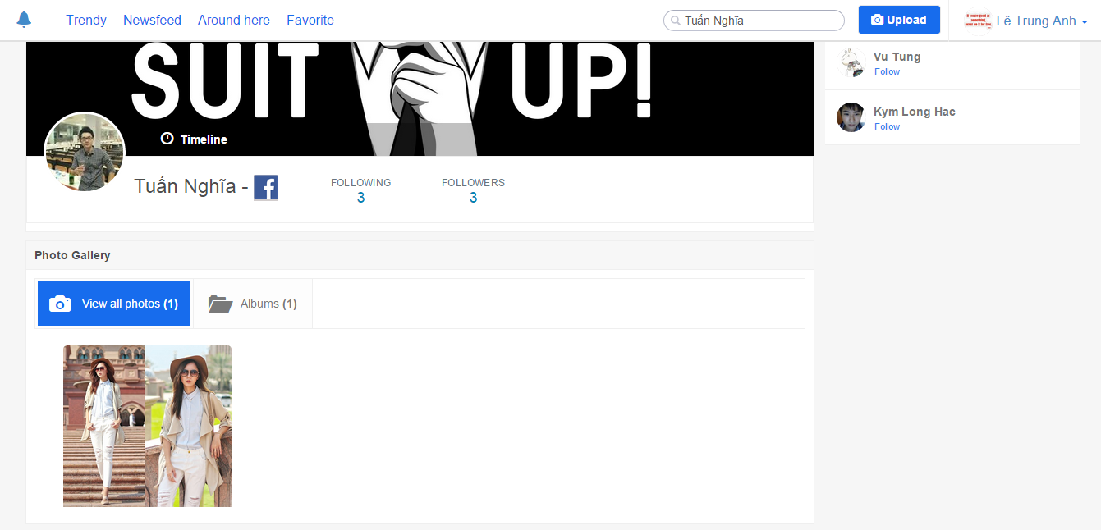
Guest
Login
View Trendy
View Newsfeed
View User page
View Around here
My Location
View Album
View Post
View Shop on Map
Suggestion

Slide 24
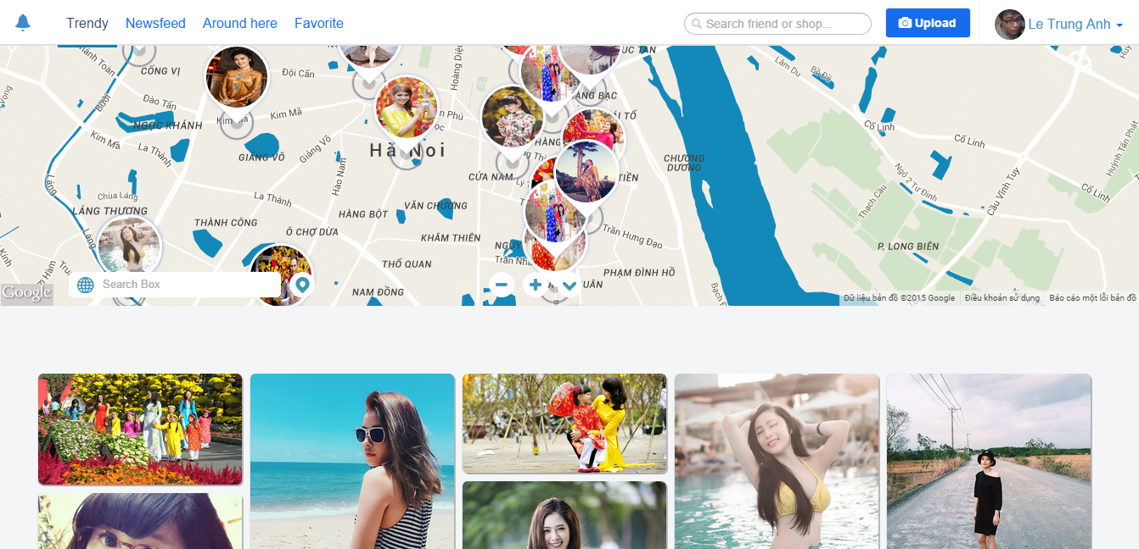
Guest
Login
View Trendy
View Newsfeed
View User page
View Around here
My Location
View Album
View Post
View Shop on Map
Suggestion

Slide 25
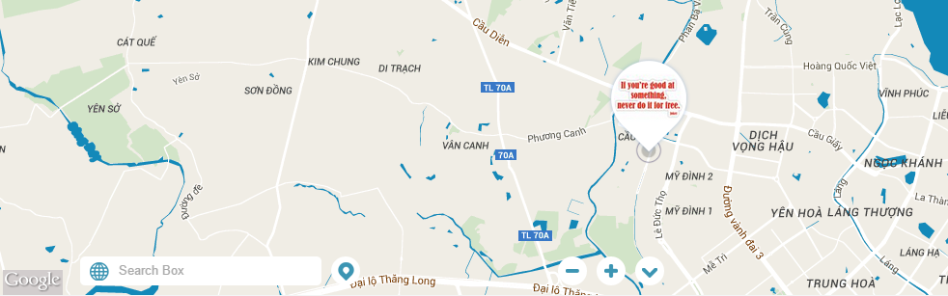
Guest
Login
View Trendy
View Newsfeed
View User page
View Around here
My Location
View Album
View Post
View Shop on Map
Suggestion

Slide 26
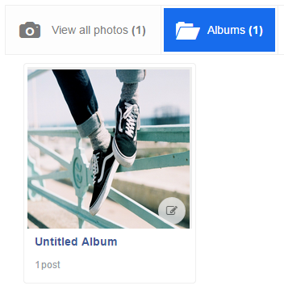
Guest
Login
View Trendy
View Newsfeed
View User page
View Around here
My Location
View Album
View Post
View Shop on Map
Suggestion

Slide 27
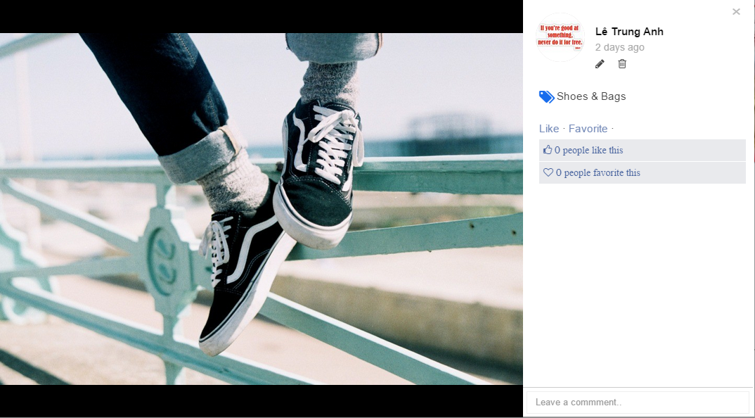
Guest
Login
View Trendy
View Newsfeed
View User page
View Around here
My Location
View Album
View Post
View Shop on Map
Suggestion

Slide 28
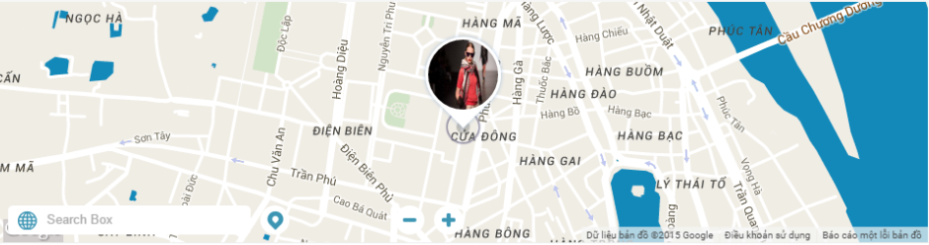
Guest
Login
View Trendy
View Newsfeed
View User page
View Around here
My Location
View Album
View Post
View Shop on Map
Suggestion

Slide 29
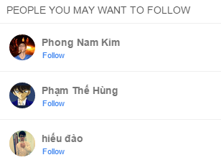
Guest
Login
View Trendy
View Newsfeed
View User page
View Around here
My Location
View Album
View Post
View Shop on Map
Suggestion

Slide 30
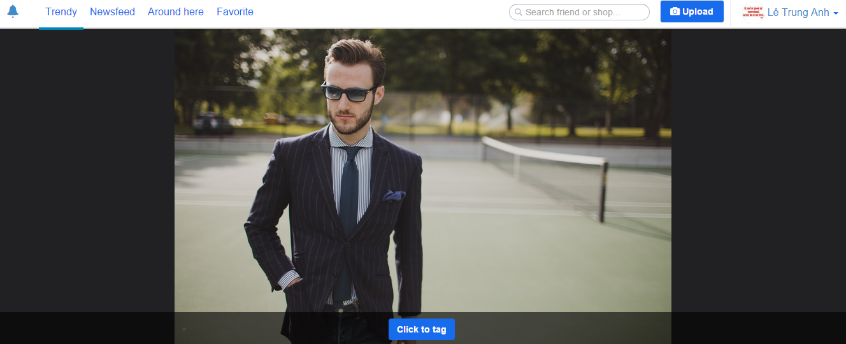
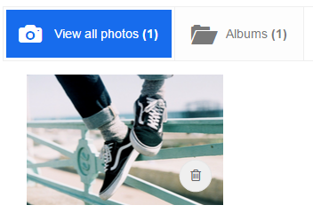
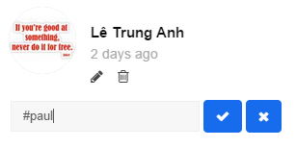
Registered User
Manage Post
Manage Album
Manage Shop
Editor Image
Image Tagging
Content Tagging
Suggest Shop
Suggest Shop’s Information
View Shop Detail
Manage Follow

Slide 31
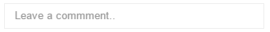
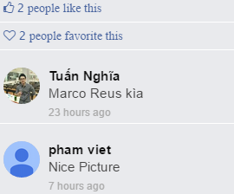
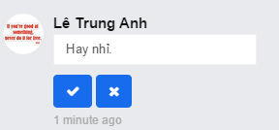
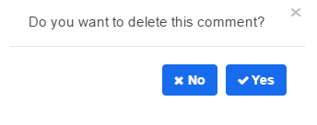
Registered User
Manage Post
Manage Album
Manage Shop
Editor Image
Image Tagging
Content Tagging
Suggest Shop
Suggest Shop’s Information
View Shop Detail
Manage Follow

Slide 32
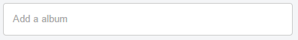
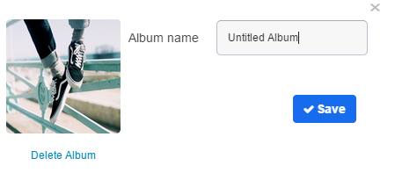
Registered User
Manage Post
Manage Album
Manage Shop
Editor Image
Image Tagging
Content Tagging
Suggest Shop
Suggest Shop’s Information
View Shop Detail
Manage Follow

Slide 33
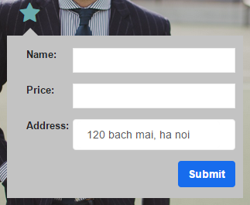
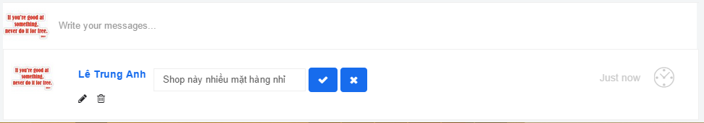
Registered User
Manage Post
Manage Album
Manage Shop
Editor Image
Image Tagging
Content Tagging
Suggest Shop
Suggest Shop’s Information
View Shop Detail
Manage Follow

Slide 34
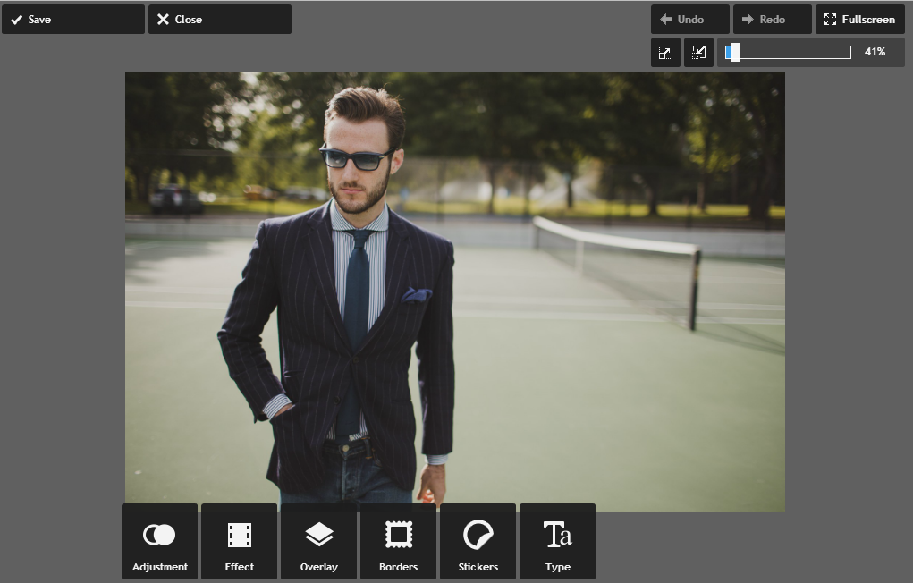
Registered User
Manage Post
Manage Album
Manage Shop
Editor Image
Image Tagging
Content Tagging
Suggest Shop
Suggest Shop’s Information
View Shop Detail
Manage Follow

Slide 35
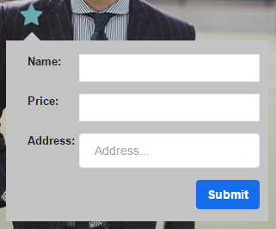
Registered User
Manage Post
Manage Album
Manage Shop
Editor Image
Image Tagging
Content Tagging
Suggest Shop
Suggest Shop’s Information
View Shop Detail
Manage Follow

Slide 36
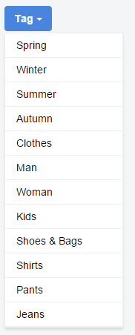
Registered User
Manage Post
Manage Album
Manage Shop
Editor Image
Image Tagging
Content Tagging
Suggest Shop
Suggest Shop’s Information
View Shop Detail
Manage Follow

Slide 37
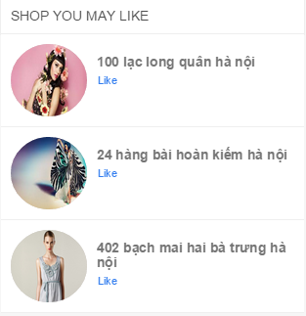
Registered User
Manage Post
Manage Album
Manage Shop
Editor Image
Image Tagging
Content Tagging
Suggest Shop
Suggest Shop’s Information
View Shop Detail
Manage Follow

Slide 38
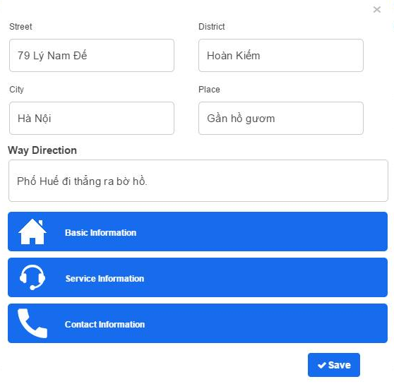
Registered User
Manage Post
Manage Album
Manage Shop
Editor Image
Image Tagging
Content Tagging
Suggest Shop
Suggest Shop’s Information
View Shop Detail
Manage Follow

Slide 39
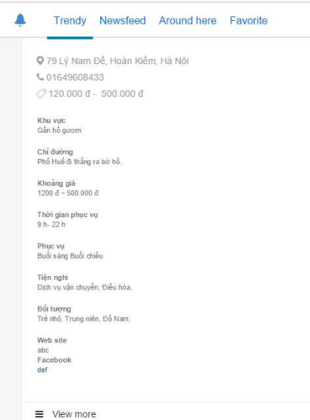
Registered User
Manage Post
Manage Album
Manage Shop
Editor Image
Image Tagging
Content Tagging
Suggest Shop
Suggest Shop’s Information
View Shop Detail
Manage Follow

Slide 40
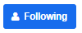
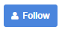
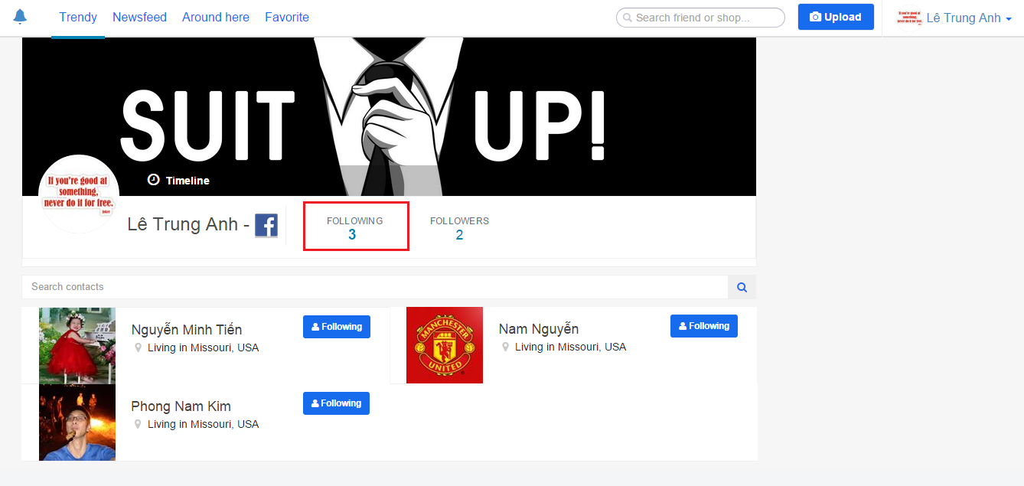
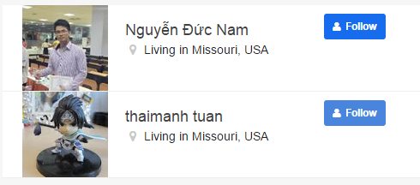
Registered User
Manage Post
Manage Album
Manage Shop
Editor Image
Image Tagging
Content Tagging
Suggest Shop
Suggest Shop’s Information
View Shop Detail
Manage Follow

Slide 41
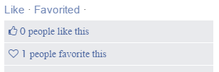
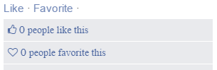
Registered User
Manage Favorite
Notification
Change Cover
Search
Logout

Slide 42
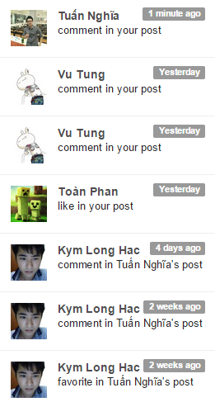
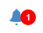
Registered User
Manage Favorite
Notification
Change Cover
Search
Logout

Slide 43

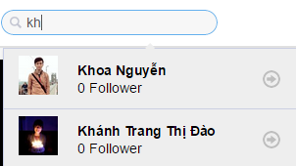
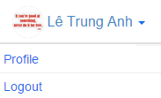
Registered User
Manage Favorite
Notification
Change Cover
Search
Logout

Slide 44
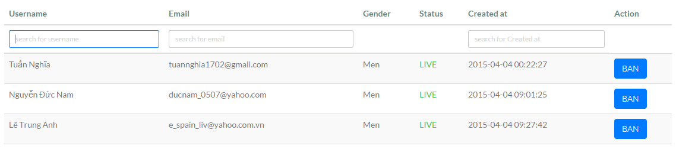

Administrator
Search User
Search Shop
View All User
Delete Post
View All Shop
Update Information Shop
Ban User
Unban User
Show Report

Slide 45


Administrator
Search User
Search Shop
View All User
Delete Post
View All Shop
Update Information Shop
Ban User
Unban User
Show Report

Slide 46
Administrator
Search User
Search Shop
View All User
Delete Post
View All Shop
Update Information Shop
Ban User
Unban User
Show Report

Slide 47


Administrator
Search User
Search Shop
View All User
Delete Post
View All Shop
Update Information Shop
Ban User
Unban User
Show Report

Slide 48


Administrator
Search User
Search Shop
View All User
Delete Post
View All Shop
Update Information Shop
Ban User
Unban User
Show Report

Slide 49

Administrator
Search User
Search Shop
View All User
Delete Post
View All Shop
Update Information Shop
Ban User
Unban User
Show Report

Slide 50
Non – Functional Requirement
Usability | Security | Maintainability | Performance
The user interface should be elegant, simple easy to use. | Apply social network (Facebook, Google, Twitter) token to restrict user access. | Follow coding convention, comment before each function. | Database in 3NF.
 |  | Follow Object – Oriented - Programing paradigm. | Review code to reduce unnecessary code.
 |  | Follow layered architecture, modular software and component- based development.
59
Use Case

Slide 51
Content
1
Project Background
2
Project Management Plan
3
Requirement Specification
4
Software Design
5
Testing
6
Lesson Learned
7
Demo – Q&A

Slide 52



Architectural Design
RESTful API
59
Design Patterns
Repository
Dependency Injection
Inversion of control
Design Patterns PHP Author: Dominik Liebler
Use Case

Slide 53

Architectural Design
TrendyPlus Application
59
Advantages
of using AngularJS
Model – View – Whatever pattern
Two way data binding
Route
Templates
Use Case

Slide 54
Algorithm
Using in Statistics
Based on CronJob Technology in Linux
ZScore
ZScore
59
Real Time
Dispacher
Item – to – Item Suggestion
Use Case
ZScore’s Flowchart

Slide 55



ZScore & Dispacher
Add in Post table in Database
Use this formula build Zscore Algorithm
59
Use Case
day | Interaction | Sqr_interaction | zScore
How Zscore formula implement
x | Interaction in current day
Mean | Interaction / day
Standard deviation | $$\sqrt{\frac{sqr_interaction}{day}−{mean}^{2}}$$
Help run Zscore Algorithm every day at specific time

Slide 56

ZScore’s Flowchart
59
Use Case

Slide 57
Algorithm
ZScore
59
Real – Time Architectural Overview
Real – Time
Item – to – Item Suggestion
Use Case
Notification’s Flowchart

Slide 58





Real – Time Architectural Overview
Using for
Publish – Subscribe
Save Notification to MySQL
59
Use Case
Emit
Data
Publish Data
Publish Data
To Which Client Subscribe
To Notification Channel
Asynchronous Programming
Key – Value Store in Memory
Interaction
Interaction
Interaction

Slide 59

Notification’s Flowchart
59
Use Case

Slide 60
Algorithm
ZScore
59
Real Time
Item – to – Item Suggestion
Item – to – Item Suggestion
Use Case
Suggestion’s Flowchart

Slide 61


Item – to – Item Suggestion
 | Shop1 | Shop2 | Shop3 | Shop4
User1 | 1 | 1 | 0 | 0
User2 | 0 | 1 | 1 | 0
User3 | 1 | 1 | 1 | 0
59
Use Case
Cousin of The Angle
Between The Two Vectors
Calculate
cos (shop1, shop2)

Slide 62

Suggestion’s Flowchart
59
Use Case

Slide 63

Database Design
59

Slide 64

Class Diagram
59
Use Case

Slide 65

Sequence Diagram
59
Use Case

Slide 66
Content
1
Project Background
2
Project Management Plan
3
Requirement Specification
4
Software Design
5
Testing
6
Lesson Learned
7
Demo – Q&A

Slide 67
Testing Life – Cycle
Identify Requirements
Test Planning
Bug Fixing
Acceptance Testing
Test Excuting
Design Test Case
Regression Testing
Test Result Report
59
Use Case

Slide 68
Testing Life – Cycle
Phase | Activity | Deliverables | Necessity
Requirements/ Design Review | You review the software requirements/ design (Well, if they exist.) | ‘Review Defect’ Reports | Curiosity
Test Planning | Once you have gathered a general idea of what needs to be tested, you ‘plan’ for the tests. | Test Plan Test Estimation Test Schedule | Farsightedness
Test Designing | You design/ detail your tests on the basis of detailed requirements/design of the software (sometimes, on the basis of your imagination). | Test Cases / Test Scripts/Test Data Requirements Traceability Matrix | Creativity
Test Environment Setup | You setup the test environment (server/ client/ network, etc) with the goal of replicating the end-users’ environment. | Test Environment | Rich company
Test Execution | You execute your Test Cases/ Scripts in the Test Environment to see whether they pass. | Test Results (Incremental) Defect Reports | Patience
Test Reporting | You prepare various reports for various stakeholders. | Test Results (Final) Test/ Defect Metrics Test Closure Report Who Worked Late & on Weekends (WWLW) Report [Depending on how fussy your Management is] | Diplomacy
59
Use Case

Slide 69
Testing Type
Unit Testing
59
GUI Testing
Use Case
Function Testing
Regression Testing
Acceptance Testing

Slide 70



Testing Tools
Google Chrome: Used for test size of web page and size of component on page
59
Google Chrome 43.0
Use Case
Color Picker: Pixel Perfect Tool from Google Chrome Application used for read color ID of Picture and web page
HostedRedmine: Log bug. (www.hostedredmine.com).

Slide 71
Testing Environment
Software: Google Chrome 43.0
Hardware:
- Windows 8 Professional 64-bit, Service Pack 1
- Inter® Core™ i3 CPU
- Install memory (RAM) : 4.00GB
59
Use Case

Slide 72

Testing Model
59
Use Case

Slide 73

Test Case Guideline
59
Use Case

Slide 74

Test Case Sample
Normal Flow
Alternative Flow
59
Login to TrendyPlus System.
Click to image top 1 TrendyPlus.
Click to button to edit caption image.
Input text.
Click to button
Login to TrendyPlus System.
Click to image top 1 TrendyPlus.
Click to button to edit caption image.
Press to “ESC” on keyboard.
Use Case

Slide 75
Process Log Bug (Follow FSoft)
1. Tester detects bug → log bug in hostedredmind.com with status assigned and assign coder fix.
2. Coder fixed bug → change status bug on hostedredmind.com to resolved and assign tester check again.
3. Tester check bug again
If bug fixed, change status bug on hostedredmind.com to resolved.
If bug didn’t fixed, change status bug on hostedredmind.com to assign again coder fix.
59
Use Case

Slide 76

Test Case Detected Bug
59
Use Case

Slide 77

Bugs Logged
59
Use Case

Slide 78

Bug List Report
59
Use Case

Slide 79
Test Report Phase 1
No | Module Test | Pass | Fail | Untested | Number of test cases
1 | Login-1 | 76 | 0 | 0 | 76
2 | Login-2 | 72 | 0 | 0 | 72
3 | Login-3 | 0 | 0 | 72 | 72
4 | Logout | 3 | 0 | 0 | 3
5 | CacheLogin | 4 | 0 | 0 | 4
6 | TimeOut | 4 | 0 | 0 | 4
7 | Screen | 23 | 28 | 11 | 62
8 | Map | 15 | 3 | 0 | 18
9 | Shop | 34 | 0 | 0 | 34
10 | Post and album | 83 | 0 | 0 | 83
11 | Follow | 4 | 15 | 0 | 19
12 | Trendy | 3 | 0 | 0 | 3
13 | Admin | 0 | 0 | 0 | 30
14 | Other | 34 | 2 | 0 | 36
 | Sub total | 355 | 48 | 83 | 516
 | Test coverage |  | 82.92 | %
 | Test successful coverage |  | 73.05 | %
59
Use Case

Slide 80
Test Report Phase 2
No | Module Test | Pass | Fail | Untested | Number of test cases
1 | Login-1 | 76 | 0 | 0 | 76
2 | Login-2 | 72 | 0 | 0 | 72
3 | Login-3 | 72 | 0 | 0 | 72
4 | Logout | 3 | 0 | 0 | 3
5 | CacheLogin | 4 | 0 | 0 | 4
6 | TimeOut | 4 | 0 | 0 | 4
7 | Screen | 43 | 19 | 0 | 62
8 | Map | 18 | 0 | 0 | 18
9 | Shop | 26 | 8 | 0 | 34
10 | Post and album | 77 | 6 | 0 | 83
11 | Follow | 4 | 15 | 0 | 19
12 | Trendy | 3 | 0 | 0 | 3
13 | Admin | 11 | 19 | 0 | 30
14 | Other | 36 | 0 | 0 | 36
 | Sub total | 449 | 67 | 0 | 516
 | Test coverage |  | 100.00 | %
 | Test successful coverage |  | 87.02 | %
59
Use Case

Slide 81
Test Report Final
No | Module Test | Pass | Fail | Untested | Number of test cases
1 | Login-1 | 76 | 0 | 0 | 76
2 | Login-2 | 72 | 0 | 0 | 72
3 | Login-3 | 72 | 0 | 0 | 72
4 | Logout | 3 | 0 | 0 | 3
5 | CacheLogin | 4 | 0 | 0 | 4
6 | TimeOut | 4 | 0 | 0 | 4
7 | Screen | 62 | 0 | 0 | 62
8 | Map | 18 | 0 | 0 | 18
9 | Shop | 34 | 0 | 0 | 34
10 | Post and album | 83 | 0 | 0 | 83
11 | Follow | 19 | 0 | 0 | 19
12 | Trendy | 3 | 0 | 0 | 3
13 | Admin | 30 | 0 | 0 | 30
14 | Other | 36 | 0 | 0 | 36
 | Sub total | 516 | 0 | 0 | 516
 | Test coverage |  | 100.00 | %
 | Test successful coverage |  | 100.00 | %
59
Use Case

Slide 82
Content
1
Project Background
2
Project Management Plan
3
Requirement Specification
4
Software Design
5
Testing
6
Lesson Learned
7
Demo – Q&A

Slide 83




Lesson Learned
59
Use Case
Team Work
Overcome Difficulties
Management Skill
New Technology

Slide 84
Content
1
Project Background
2
Project Management Plan
3
Requirement Specification
4
Software Design
5
Testing
6
Lesson Learned
7
Demo – Q&A

Slide 85


Demo – Q&A
59
Use Case

